Slide 1
Data Science Techniques and Real-
World Applications
Data Wrangling (Munging)
Zahra Sharafi
https://sites.google.com/view/zahrasharafi/home
Email: z.sharafi@fs.de
1
Notes:
1

Slide 2

2

Slide 3

Agenda
Data Wrangling (ch2. Data Analytics for Business, Economics, and Policy)
understand types of variables and observations;
organize data in a tidy way;
merging tidy tables
clean the data:
identify and address problems with observations and variables;
create a reproducible workflow to clean and organize data;
document data cleaning and understand such documentation.
Pandas
3

Slide 4
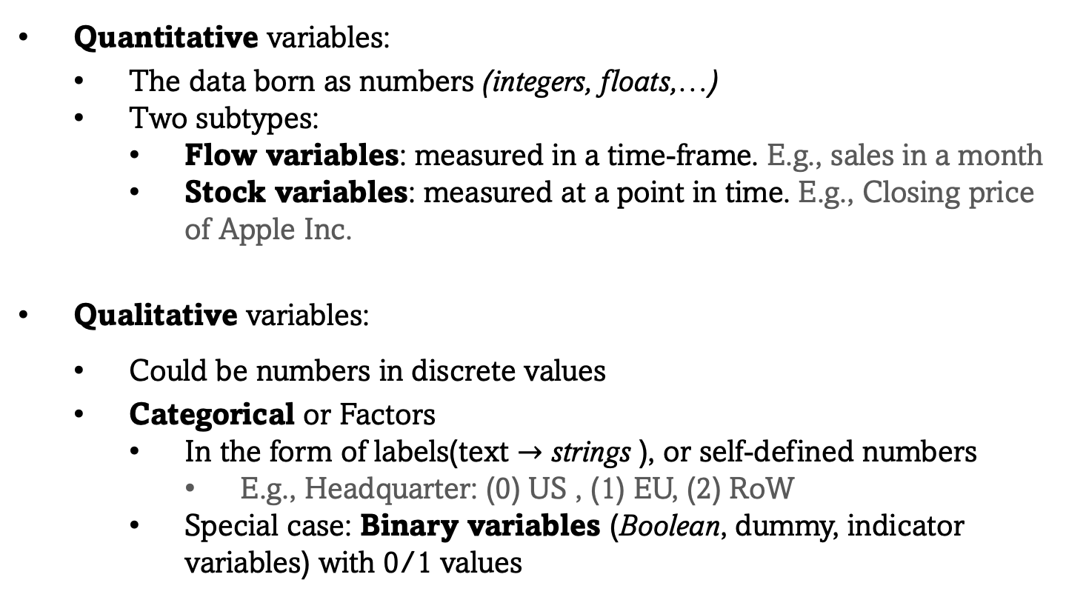
﻿Types of Variables
Quantitative variables:
The data born as numbers (integers, floats,…)
Two subtypes:
Flow variables: measured in a time-frame. E.g., sales in a month
Stock variables: measured at a point in time. E.g., Closing price of Apple Inc.
Qualitative variables:
Could be numbers in discrete values
Categorical or Factors
In the form of labels(text $→$ strings ), or self-defined numbers
E.g., Headquarter: (0) US , (1) EU, (2) RoW
Special case: Binary variables (Boolean, dummy, indicator variables) with 0/1 values
4

Slide 5
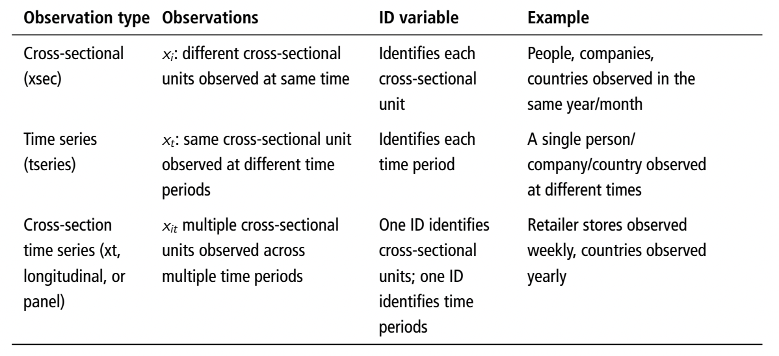
﻿Types of Observations
5

Slide 6
Tidy Data
A tidy dataset, organized as one or many data tables in a way that:
﻿In a data table, each observation forms a row.
In a data table, each variable forms a column.
Each kind of observation forms a data table.
In the relational datasets: A clear link exists (and is documented) between the tables
Example:
﻿A dataset on customer purchases of various products:
a data table on customers (their age, income, and so on) > unique customer ID
a data table on products (type, brand, price, quality indicators) > unique product ID
a data table on purchase events (which customer purchased which product > unique purchase ID that maps customer and product IDs
6

Slide 7
Work file
You have a data analysis task to perform:
Make sure your dataset is tidy
Create a work file:
﻿combine the variables you need from the various data tables to form a single data table
Do the analysis (later in the course!)
﻿The process of pulling different variables from different data tables for well-identified entities to create a new data table is called linking, joining, merging, or matching data tables.
7

Slide 8
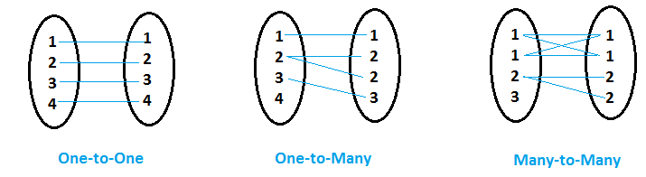
Merging
Merging types:
8

Slide 9
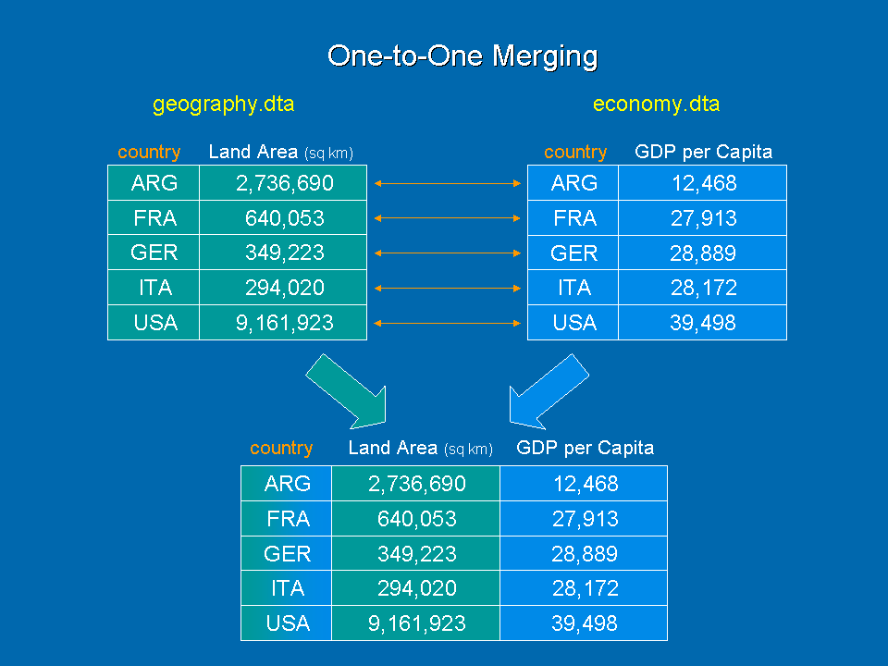
Merging
Merging types:
9

Slide 10
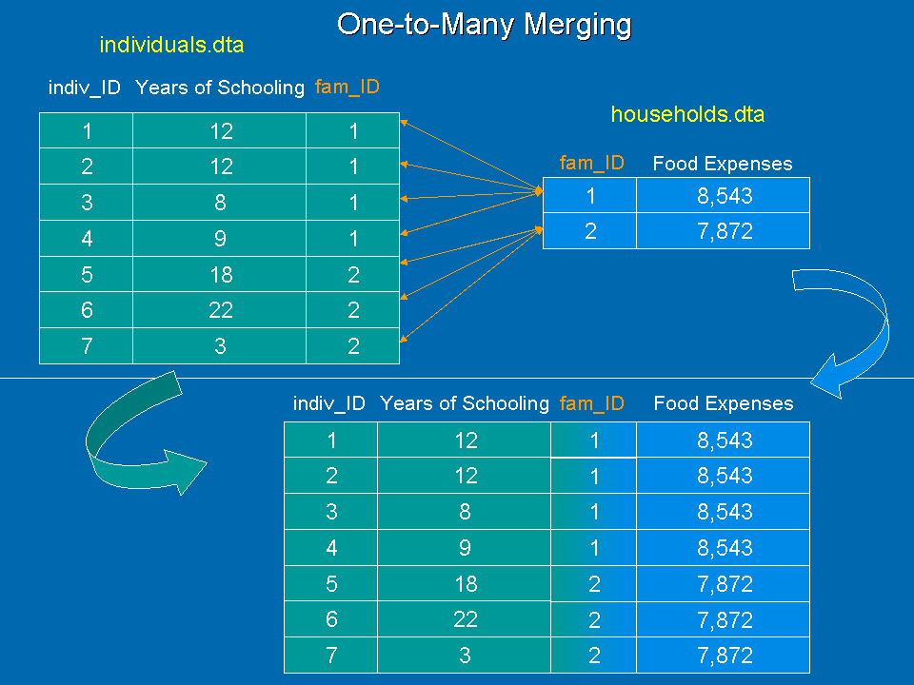
Merging
Merging types:
10

Slide 11

Merging
Merging types:
Be careful, m:m merging is rarely needed and results in an untidy data!
Try to formulate your questions in a way to be able to work in a series of m:1 matchings.
In case of tables with m & n observations, be sure that your machine is capable of having m*n obs table in memory.
Always check your post merging data (in pandas: “Validate”)
11

Slide 12
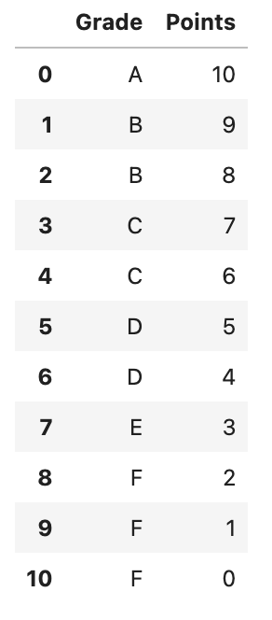
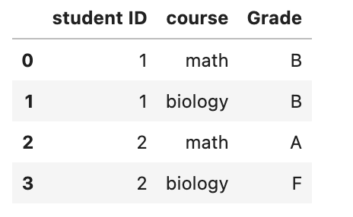
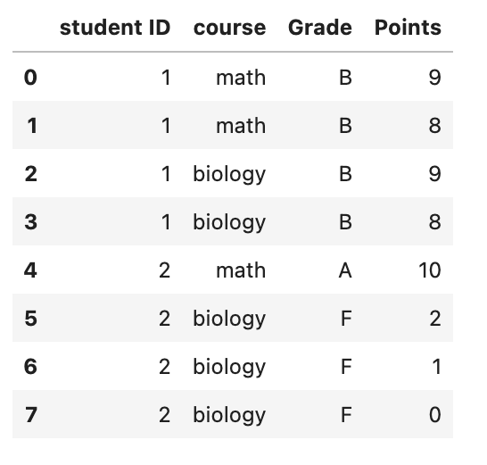
Merging
Merging types:
12

Slide 13
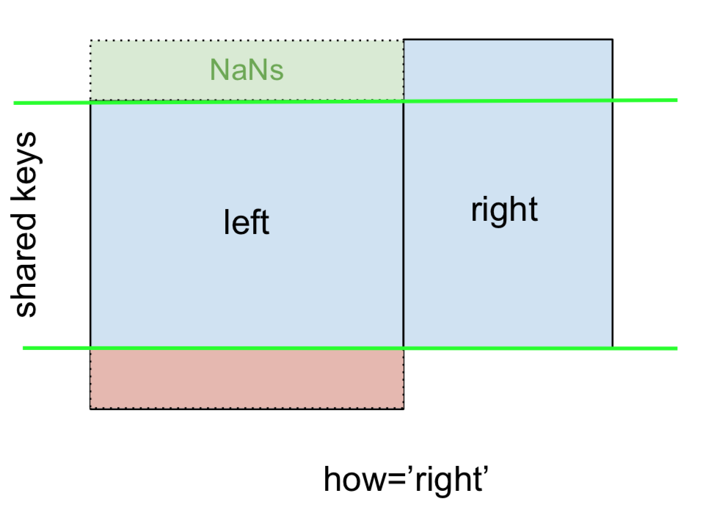
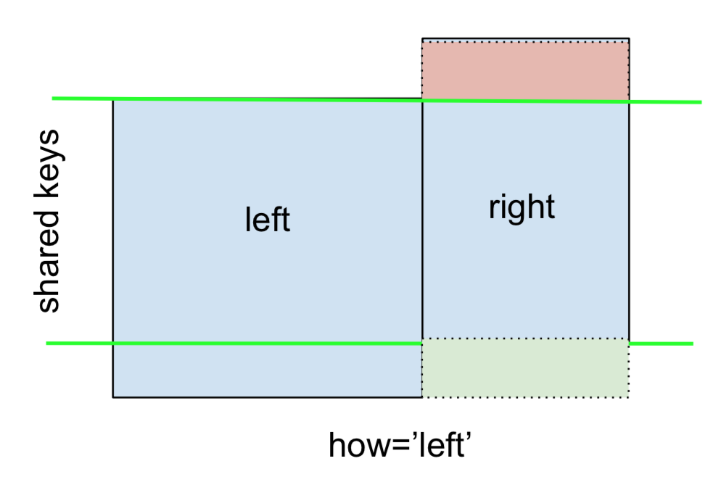
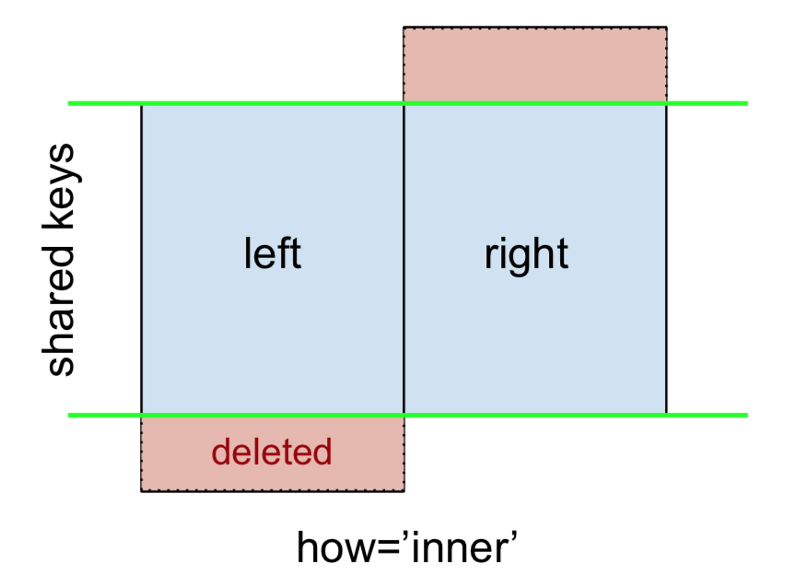
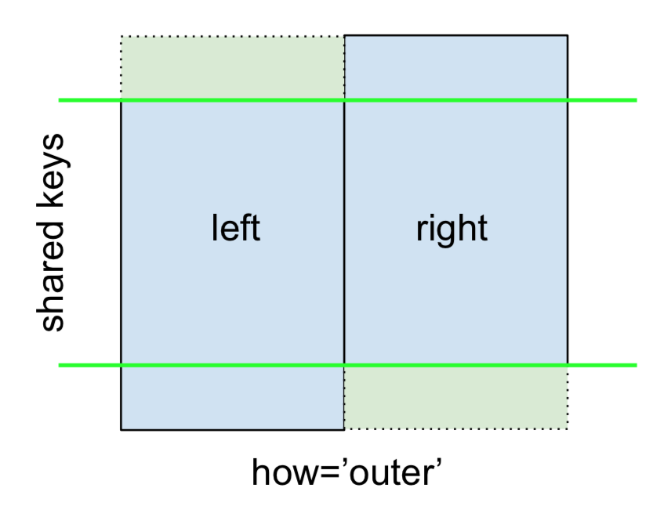
Merging
﻿When merging two data tables, be that 1:1, 1:m, m:1, or m:m matching, data analysts may be able to link all observations or only some of them.
13

Slide 14
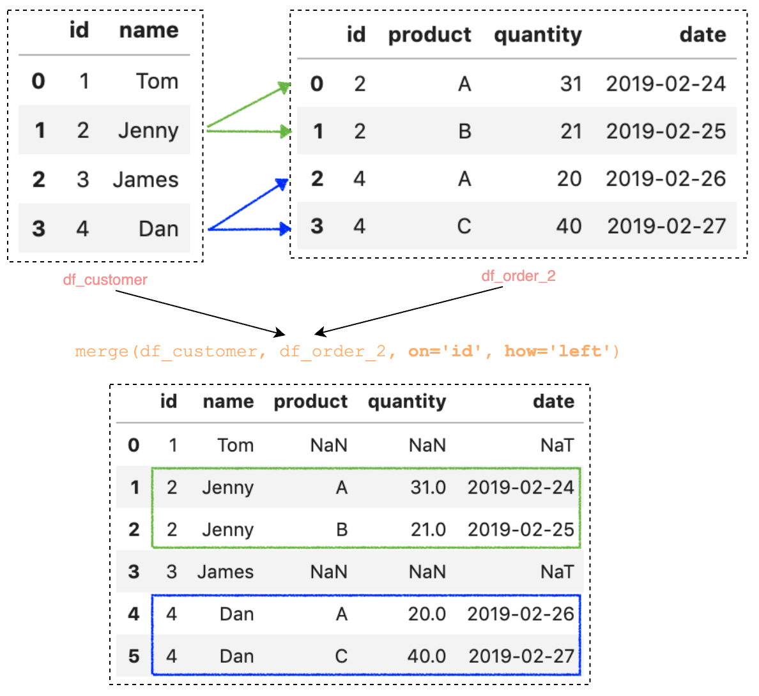
Merging
Example of one-to-many, left merge:
14

Slide 15
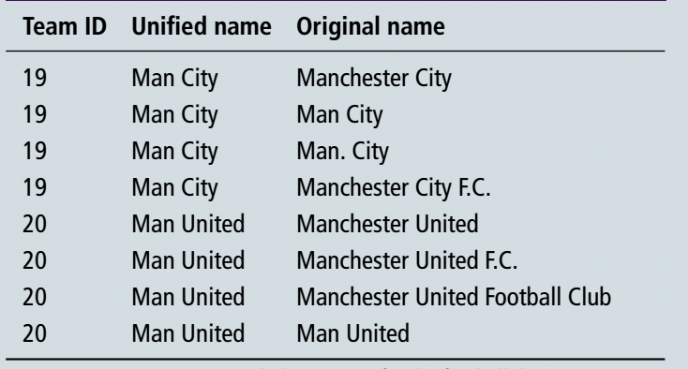
﻿Entity Resolution
Think deeply about the observation level of your data:
If you have a cross-sectional dataset, e.g., on countries, each row should represent one country.
If you have panel data, e.g., annual revenue of several companies, your observation unit is firm-year.
Check for duplicates at the observation level
Duplicates could occur during the data collection or data processing
Drop duplicates
Be careful, sometimes duplicates contain additional information:
Ambiguous identifications:
Avoid using names (strings) as identifiers
Firm | year | … | State
Apple Inc. | 2020 | … | N/A
Apple Inc. | 2020 | … | CA
15

Slide 16
Missing Values
Why are missing values problematic?
Difficult to identify:
If they are replaced with zeros in quantitative variables…
In a column of string variables, the value is like “N/A….”
The problem: your software (e.g., Pandas, R, SQL) won’t automatically recognize those as missing. It will treat them as real values.
That’s why in data cleaning, we try to explicitly convert all “fake missing indicators” (0, "N/A", "?", "None") into proper NaN values. Then they are easier to detect and handle.
Reduction in the number of observations.
Sample selection bias
If the missing values are not happening randomly…
Check the severity of the issue with “benchmarking”
Use the distribution of other variables and compare them for the missing and non-missing observations
How was the data born? Is it a survey?...
16

Slide 17
Missing Values
Handling missing values:
0. Make sure that there is no alternative dataset
Check for non-ideal alternatives
Ignore them (?)
Check for sample selection bias
Missing values are not many
Or, only a subsample of data has most of the missing values > drop that subsample in a robustness check (example: missing values for smaller companies)
Imputation
E.g., replace missing values with the mean, or higher degree polyfits
This doesn’t add information!
17

Slide 18
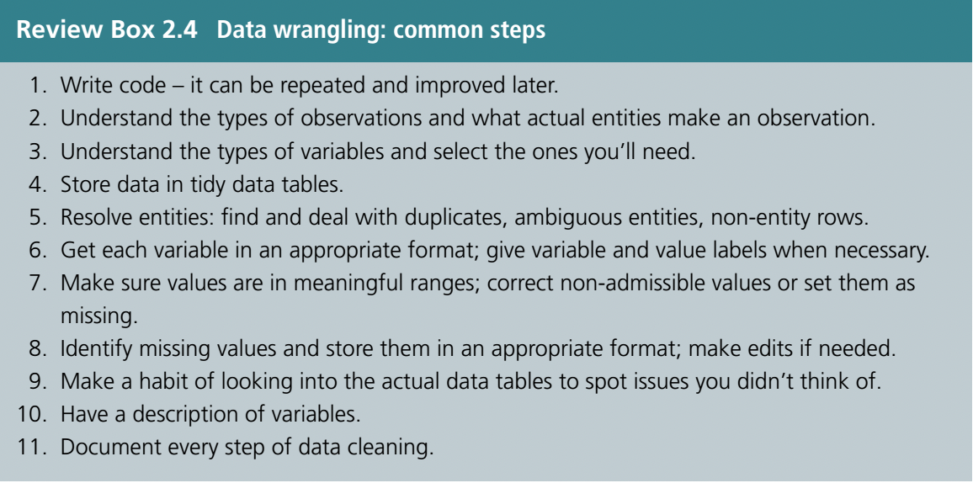
Cleaning Data
18

Slide 19
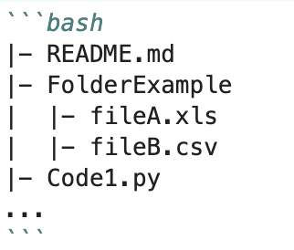
README
No one can read your mind >> create a README
A .txt or .md file located in the root folder
Contents:
Title for the dataset
Contact data
Data origin
Folder structures
For each filename, a short description of what data it contains
Licences or restrictions placed on the data
Description of methods used for data processing (describe how the data were generated from the raw or collected data)
Variable list, including full names and definitions (spell out abbreviated words) of column headings for tabular data
Definitions for codes or symbols used to record missing data
Use templates: https://data.research.cornell.edu/content/readme
19

Slide 20
Now to the code…
P3&4 Data Wrangling.ipynb
And
Homeworks 1, 2, and 3.
Submission delivery: Wednesday before the next session.

